Slide 1
Sensitivity Imp Test

Slide 2
Noise Figure Test
LNA_NoiseFigure = 0;
RxGainImbalance = 0.002;
RxI_OrgOffset = 0.0044;
RxPhaseNoise = [100, -87.133, 1000, -96.072, 1e4, -108.607];
ADC_NBits = 14;
SV_Power=-94.6dBm
VXT_OutPower=0dBm
LNA_NoiseFigure = 5;
RxGainImbalance = 0.002;
RxI_OrgOffset = 0.0044;
RxPhaseNoise = [100, -87.133, 1000, -96.072, 1e4, -108.607];
ADC_NBits = 14;
SV_Power=-94.6dBm
VXT_OutPower=0dBm
LNA_NoiseFigure = 7;
RxGainImbalance = 0.002;
RxI_OrgOffset = 0.0044;
RxPhaseNoise = [100, -87.133, 1000, -96.072, 1e4, -108.607];
ADC_NBits = 14;
SV_Power=-94.6dBm
VXT_OutPower=0dBm

Slide 3
Noise Figure Test
Noise Figure | VXT_EVM (%) | Sim_EVM (%) | Delta (%) | VXT_SNR (dB) | Sim_SNR (dB) | Delta (dB) | VXT_ Throughput (%) | Sim_ Throughput (%)
0 | 75.797 | 77.288 | 1.491 | 2.407 | 2.238 | 0.169 | 100 | 100
5 | 123.972 | 125.789 | 1.817 | -1.866 | -1.993 | 0.127 | 100 | 100
7 | 185.612 | 167.28 | 18.332 | -5.372 | -4.469 | 0.903 | 68 | 90
10 | 323.36 | 333.448 | 10.088 | -10.194 | -10.461 | 0.267 | 0 | 0

Slide 4
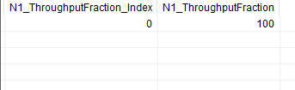
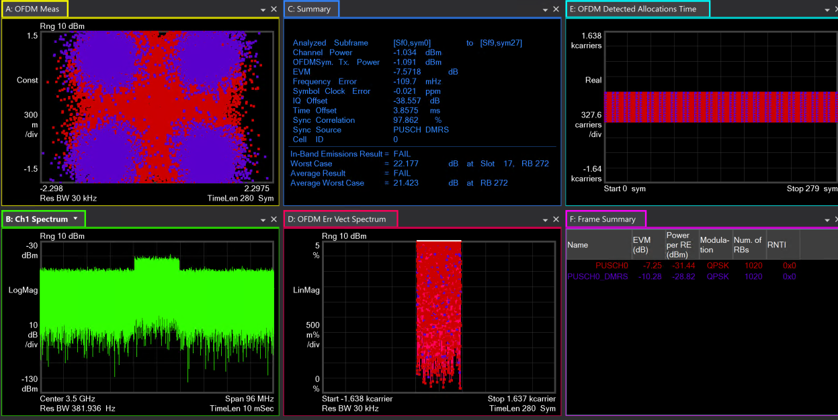
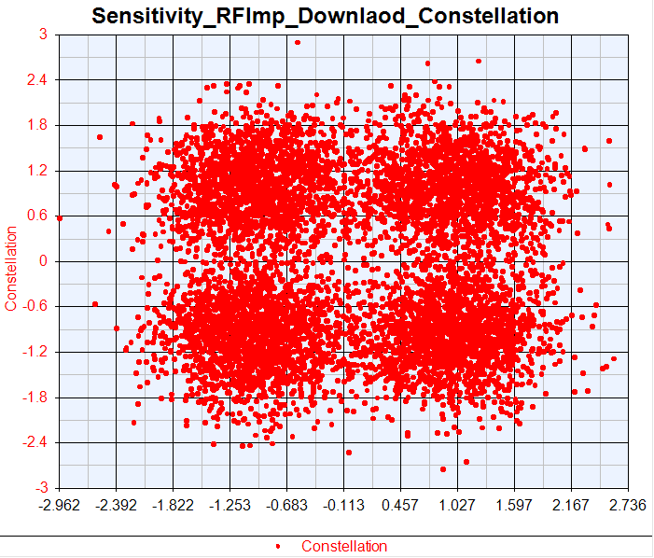
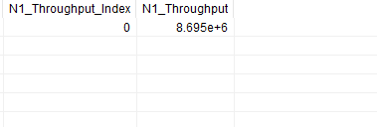
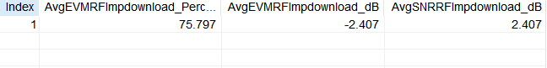
VXT Noise Figure=0

Slide 5
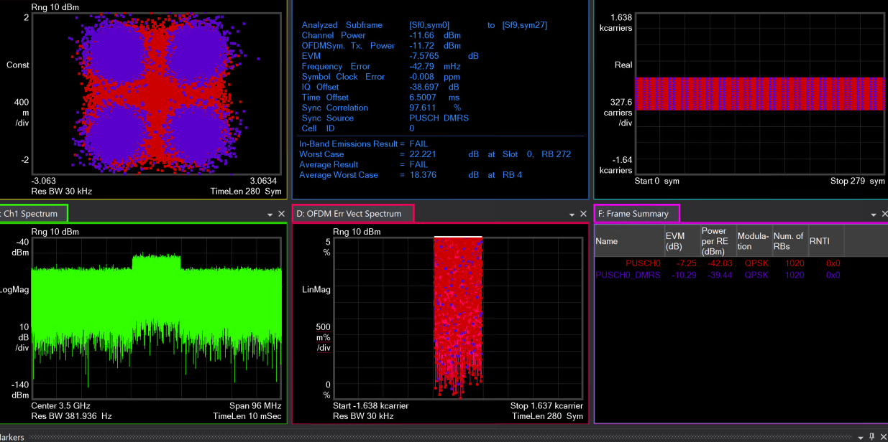
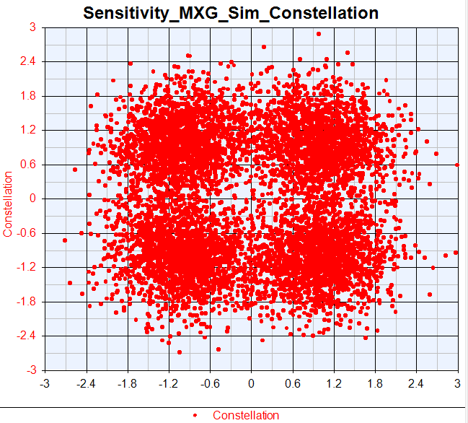
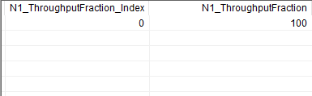
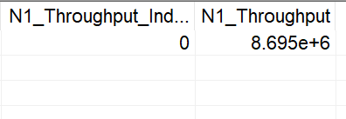
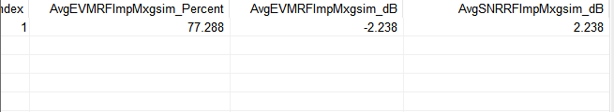
Sim Noise Figure=0

Slide 6
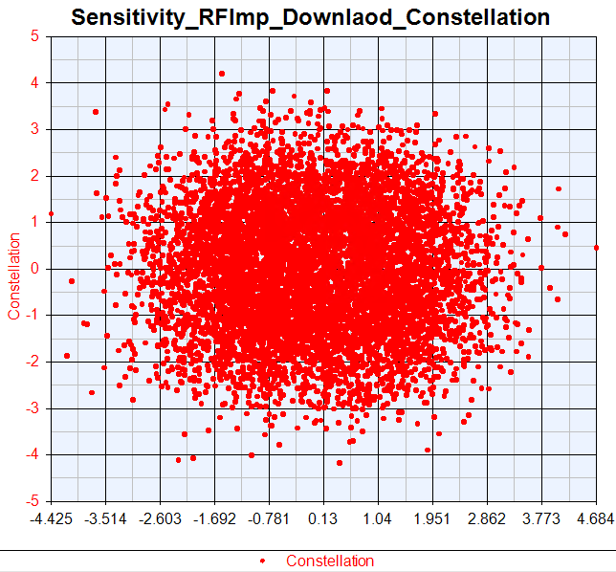
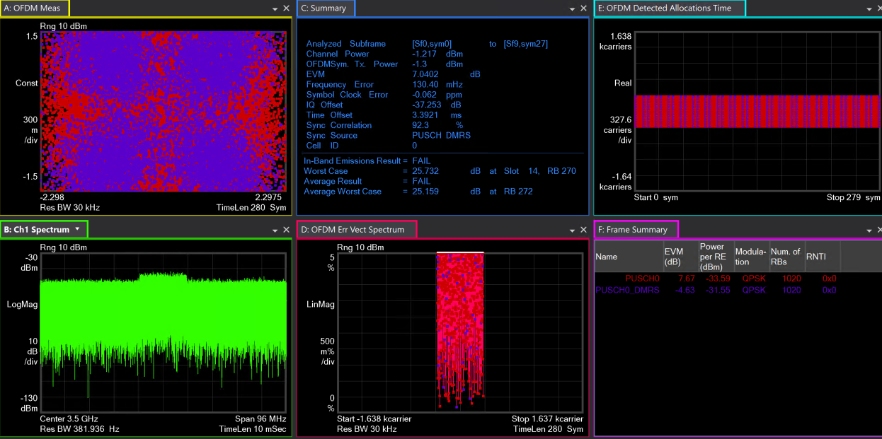
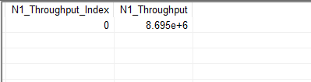
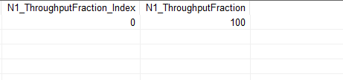
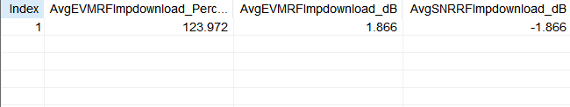
VXT Noise Figure=5

Slide 7
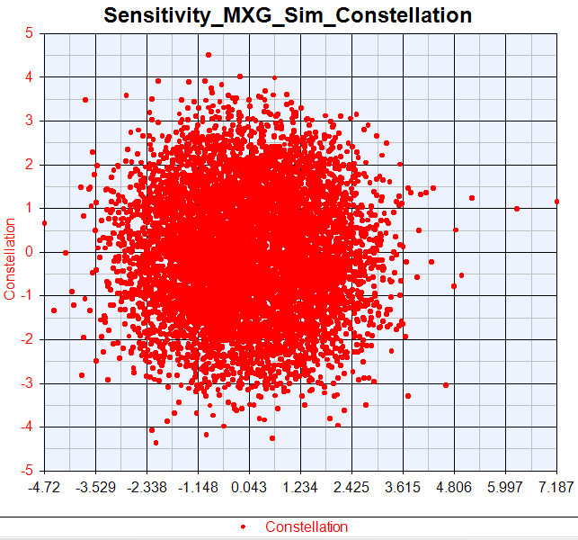
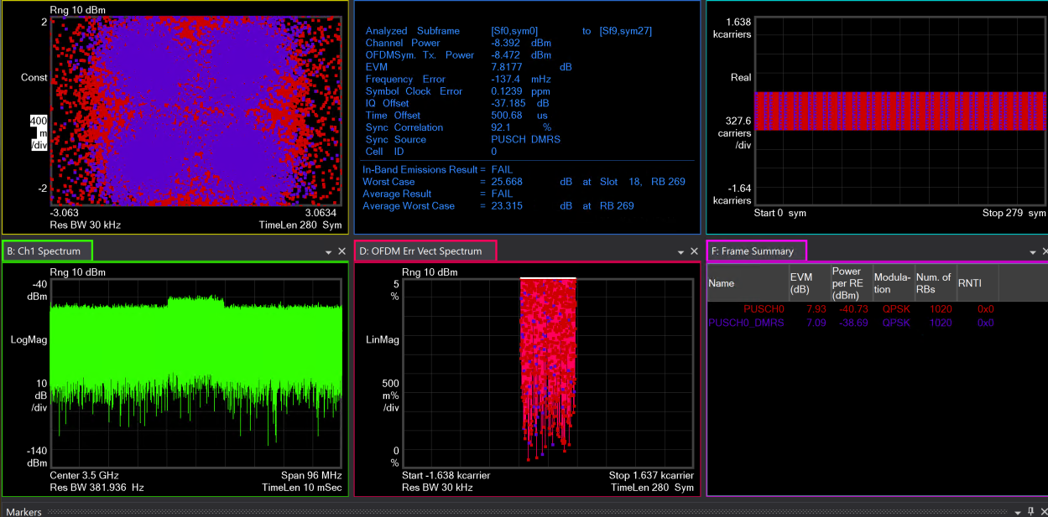
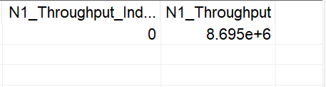
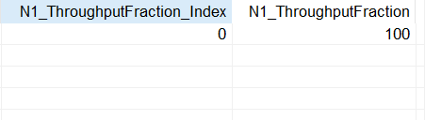
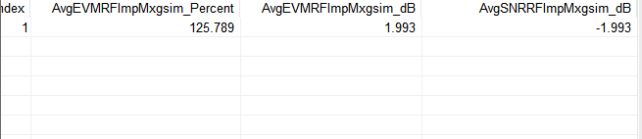
Sim Noise Figure=5

Slide 8
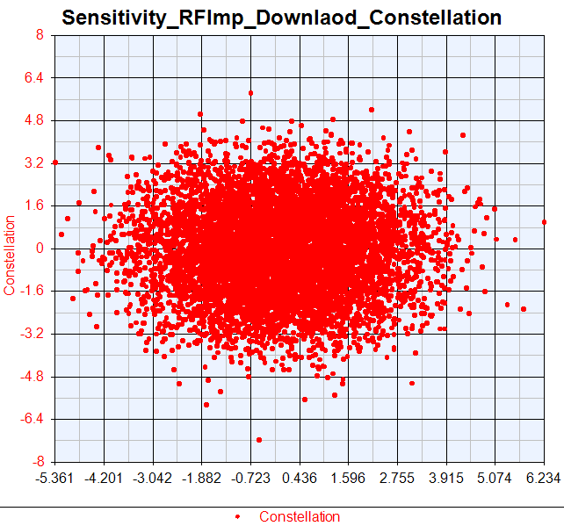
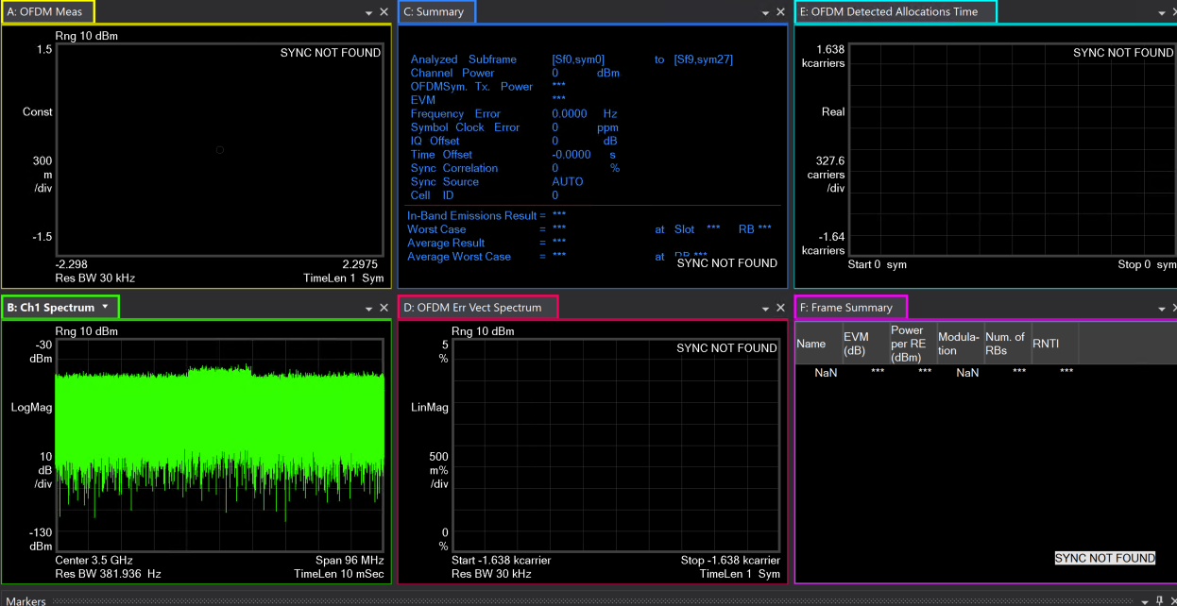
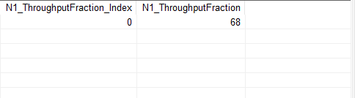
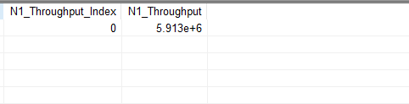
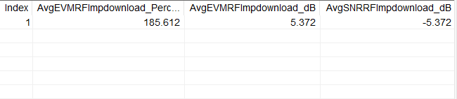
VXT Noise Figure=7

Slide 9
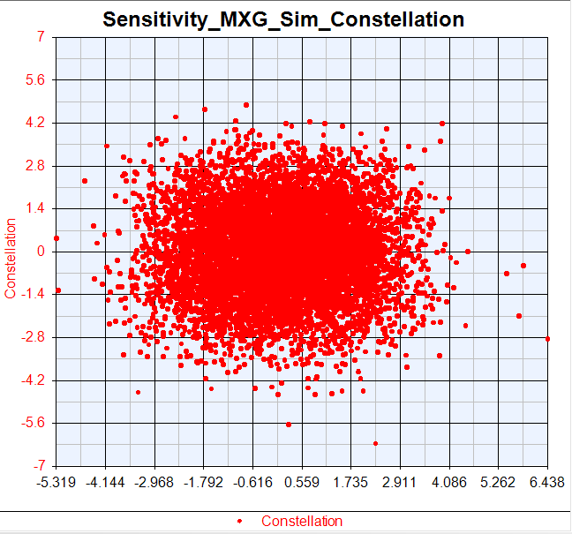
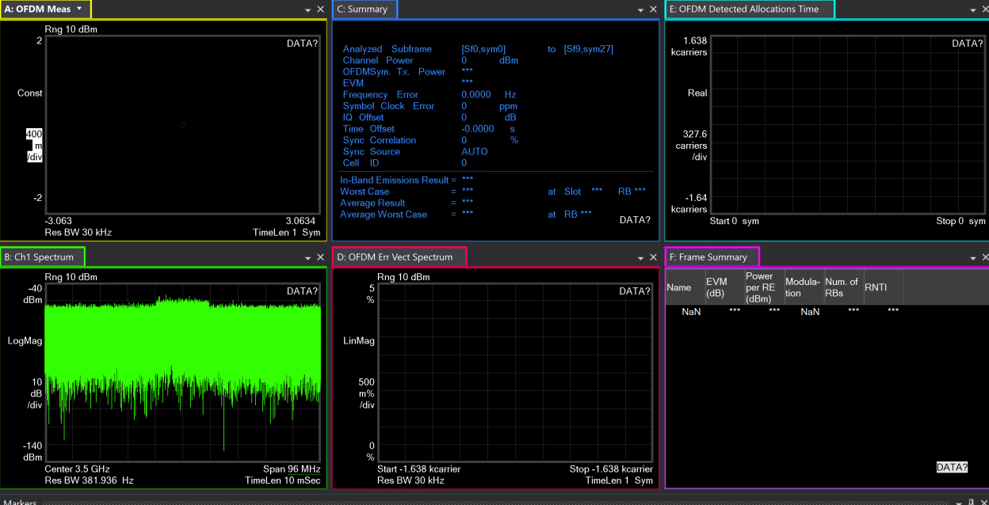
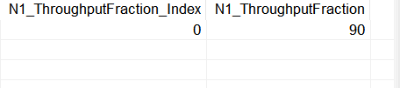
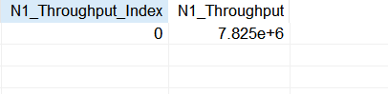
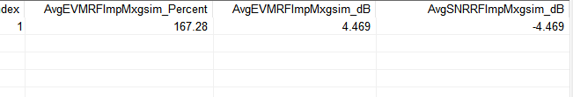
Sim Noise Figure=7

Slide 10
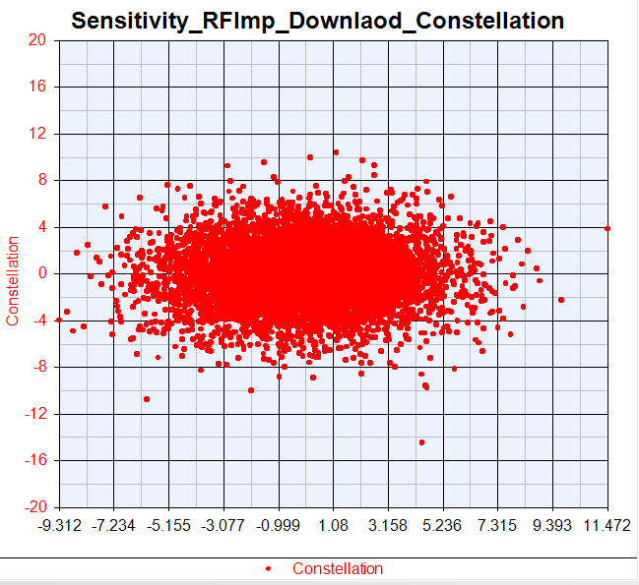
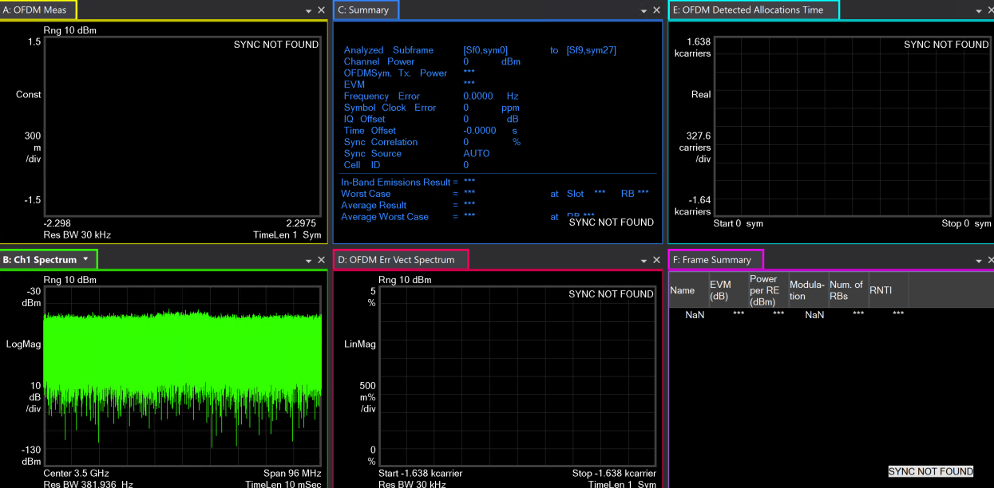
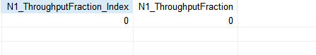
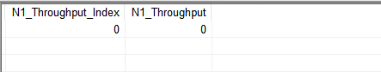
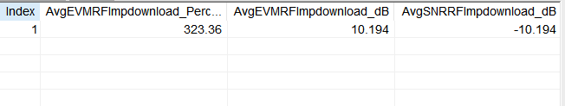
VXT Noise Figure=10

Slide 11
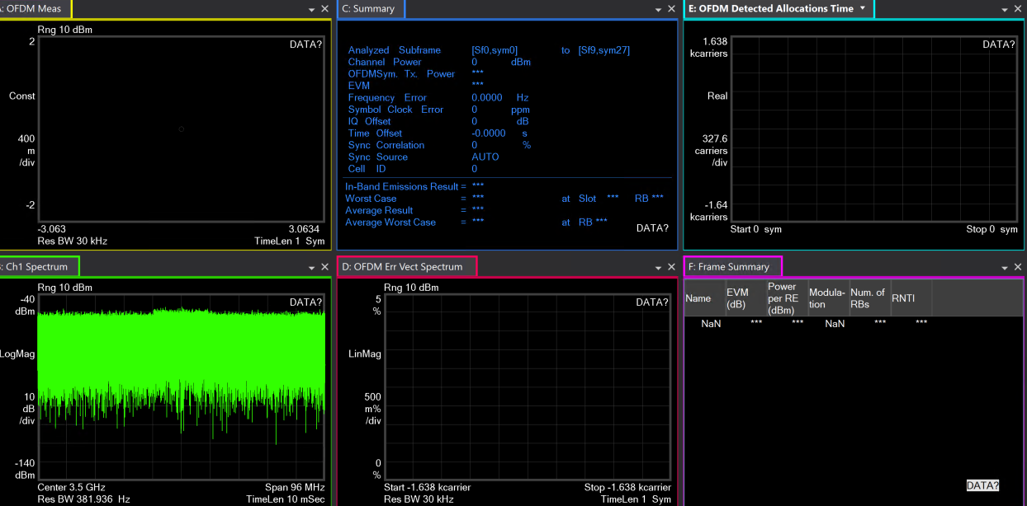
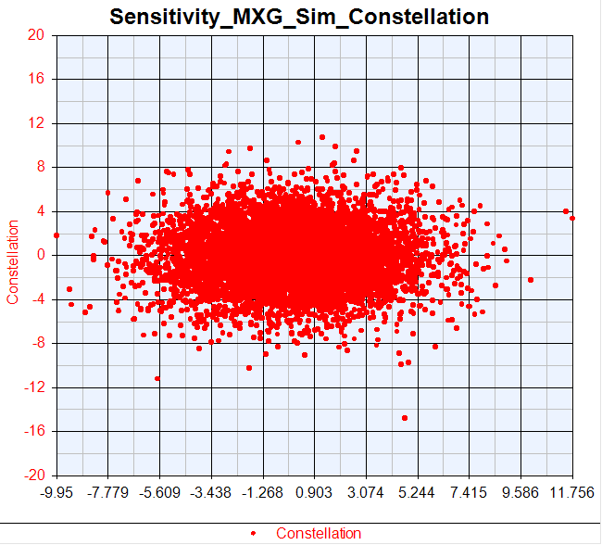
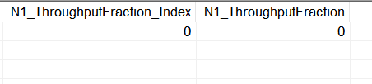
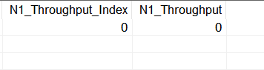
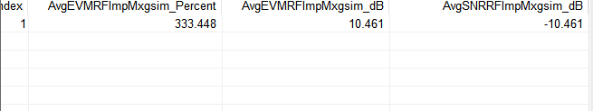
Sim Noise Figure=10

Slide 12
PhaseNoise Test
LNA_NoiseFigure = 0;
RxGainImbalance = 0.002;
RxI_OrgOffset = 0.0044;
RxPhaseNoise = [100, -87.133, 1000, -96.072, 1e4, -108.607];
ADC_NBits = 14;
SV_Power=-94.6dBm
VXT_OutPower=0dBm
LNA_NoiseFigure = 0;
RxGainImbalance = 0.002;
RxI_OrgOffset = 0.0044;
RxPhaseNoise = [100, -82.133, 1000, -91.072, 1e4, -103.607];
ADC_NBits = 14;
SV_Power=-94.6dBm
VXT_OutPower=0dBm

Slide 13
PhaseNoise Test
PhaseNoise | VXT_EVM (%) | Sim_EVM (%) | Delta (%) | VXT_SNR (dB) | Sim_SNR (dB) | Delta (dB) | VXT_ Throughput (%) | Sim_ Throughput (%)
Change 10dB | 76.216 | 78.395 | 2.179 | 2.359 | 2.114 | 0.245 | 100 | 100
Change 15dB | 78.29 | 78.628 | 0.338 | 2.126 | 2.088 | 0.038 | 100 | 100
Change 65dB | 150.145 | 139.692 | 10.453 | -3.53 | -2.903 | 0.627 | 64 | 60

Slide 14
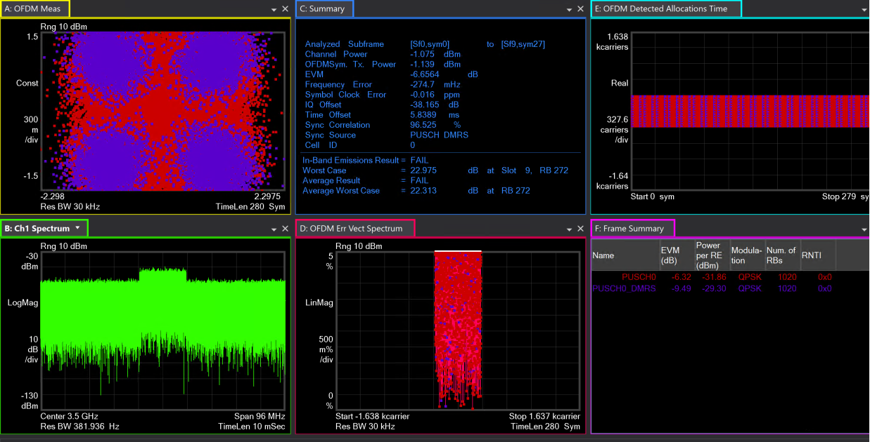
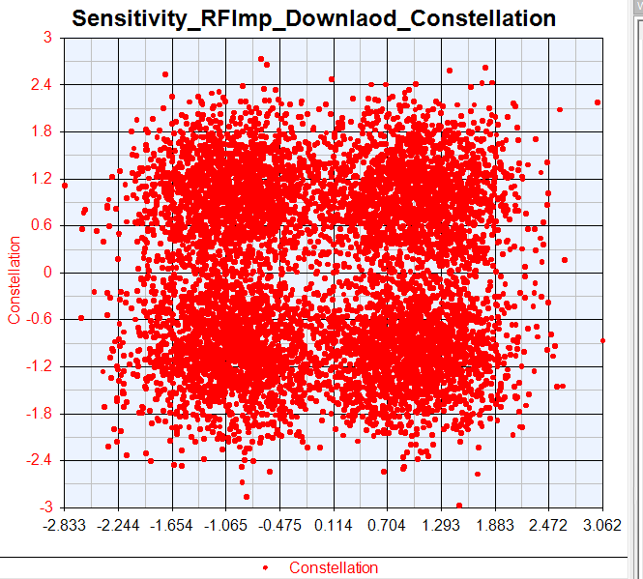
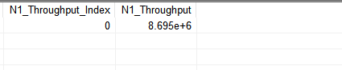
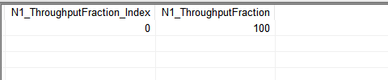
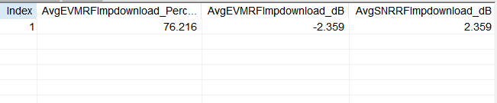
VXT PhaseNoise = [100, -87.133, 1000, -96.072, 1e4, -108.607]

Slide 15
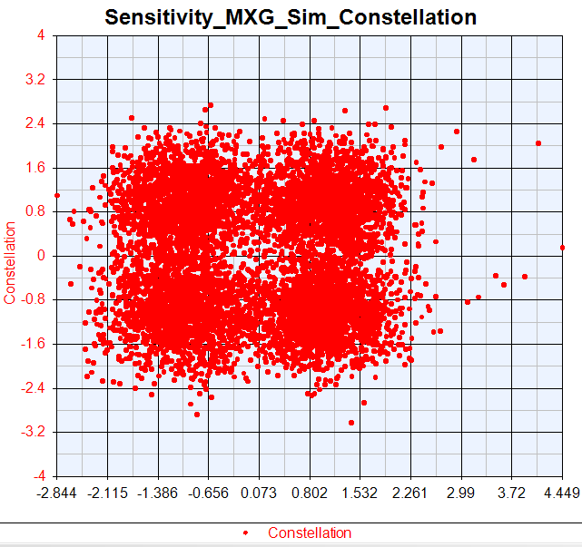
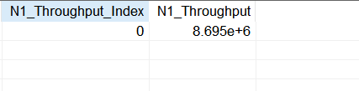
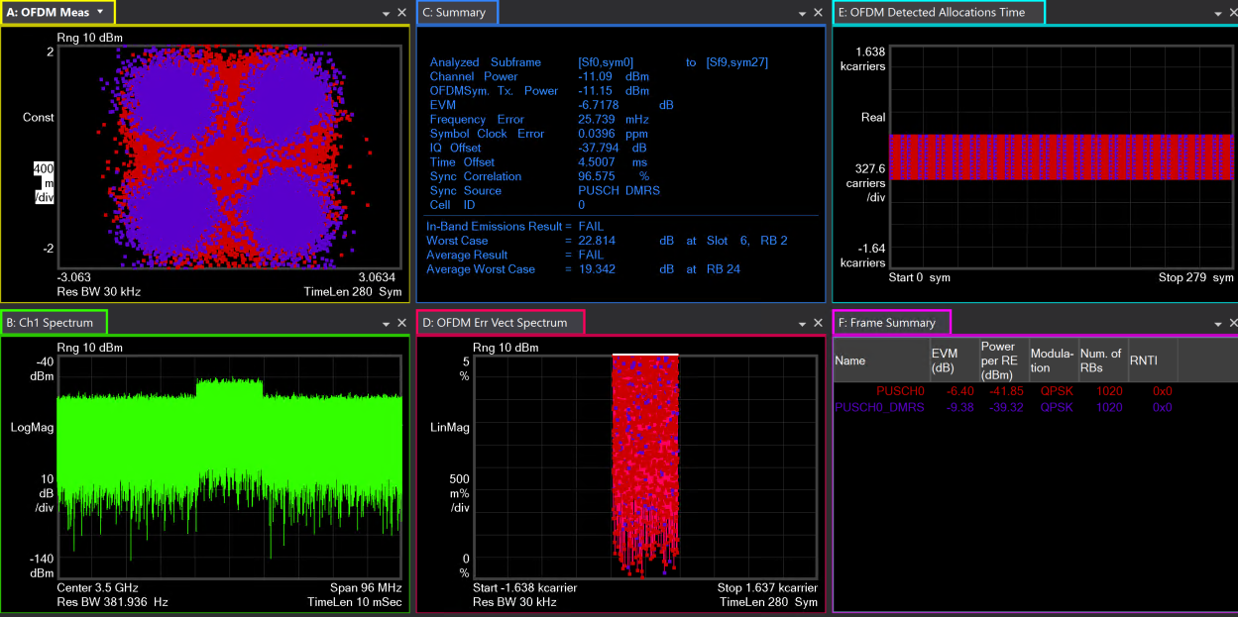
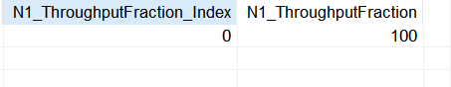
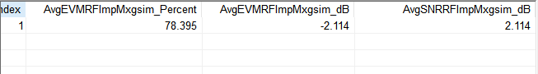
Sim PhaseNoise = [100, -87.133, 1000, -96.072, 1e4, -108.607]

Slide 16





VXT PhaseNoise = [100, -82.133, 1000, -91.072, 1e4, -103.607]

Slide 17





Sim PhaseNoise = [100, -82.133, 1000, -91.072, 1e4, -103.607]

Slide 18





VXT PhaseNoise=[100, -32.133, 1000, -41.072, 1e4, -53.607]

Slide 19





Sim PhaseNoise=[100, -32.133, 1000, -41.072, 1e4, -53.607]

Slide 20
Gain Imbalance Test
LNA_NoiseFigure = 0;
RxGainImbalance = 0.02;
RxI_OrgOffset = 0.0044;
RxPhaseNoise = [100, -97.133, 1000, -106.072, 1e4, -118.607];
ADC_NBits = 14;
SV_Power=-94.6dBm
VXT_OutPower=0dBm
LNA_NoiseFigure = 0;
RxGainImbalance = 0.03;
RxI_OrgOffset = 0.0044;
RxPhaseNoise = [100, -97.133, 1000, -106.072, 1e4, -118.607];
ADC_NBits = 14;
SV_Power=-94.6dBm
VXT_OutPower=0dBm

Slide 21
Gain Imbalance Test
Gain Imbalance | VXT_EVM (%) | Sim_EVM (%) | Delta (%) | VXT_SNR (dB) | Sim_SNR (dB) | Delta (dB) | VXT_ Throughput (%) | Sim_ Throughput (%)
0.02 | 77.61 | 79.184 | 1.574 | 2.202 | 2.027 | 0.175 | 100 | 100
0.03 | 80.095 | 82.13 | 2.035 | 1.928 | 1.71 | 0.218 | 100 | 100
20 | 151.952 | 152.79 | 0.838 | -3.634 | -3.682 | 0.048 | 88 | 70

Slide 22





VXT GainImbalance=0.02

Slide 23





Sim GainImbalance=0.02

Slide 24





VXT GainImbalance=0.03

Slide 25





Sim GainImbalance=0.03

Slide 26





VXT GainImbalance=20

Slide 27





Sim GainImbalance=20

Slide 28
IQ offset Test
LNA_NoiseFigure = 0;
RxGainImbalance = 0.002;
RxI_OrgOffset = 0.014;
RxPhaseNoise = [100, -97.133, 1000, -106.072, 1e4, -118.607];
ADC_NBits = 14;
SV_Power=-94.6dBm
VXT_OutPower=0dBm
LNA_NoiseFigure = 0;
RxGainImbalance = 0.002;
RxI_OrgOffset = 0.025;
RxPhaseNoise = [100, -97.133, 1000, -106.072, 1e4, -118.607];
ADC_NBits = 14;
SV_Power=-94.6dBm
VXT_OutPower=0dBm

Slide 29
IQ offset Test
IQ offset | VXT_EVM (%) | Sim_EVM (%) | Delta (%) | VXT_SNR (dB) | Sim_SNR (dB) | Delta (dB) | VXT_ Throughput (%) | Sim_ Throughput (%)
0.014 | 78.095 | 78.846 | 0.751 | 2.148 | 2.064 | 0.084 | 100 | 100
0.025 | 84.547 | 84.778 | 0.231 | 1.458 | 1.434 | 0.024 | 100 | 100
1.2 | 624.005 | 655.333 | 31.328 | -15.904 | -16.328 | 0.424 | 58 | 50

Slide 30





VXT IQ offset=0.014

Slide 31





Sim IQ offset=0.014

Slide 32





VXT IQ offset=0.025

Slide 33





Sim IQ offset=0.025

Slide 34





VXT IQ offset=1.2

Slide 35





Sim IQ offset=1.2

Slide 36
ADC_Nbits Test
LNA_NoiseFigure = 0;
RxGainImbalance = 0.002;
RxI_OrgOffset = 0.0044;
RxPhaseNoise = [100, -97.133, 1000, -106.072, 1e4, -118.607];
ADC_NBits = 14;
SV_Power=-94.6dBm
VXT_OutPower=0dBm
LNA_NoiseFigure = 0;
RxGainImbalance = 0.002;
RxI_OrgOffset = 0.0044;
RxPhaseNoise = [100, -97.133, 1000, -106.072, 1e4, -118.607];
ADC_NBits = 12;
SV_Power=-94.6dBm
VXT_OutPower=0dBm
LNA_NoiseFigure = 0;
RxGainImbalance = 0.002;
RxI_OrgOffset = 0.0044;
RxPhaseNoise = [100, -97.133, 1000, -106.072, 1e4, -118.607];
ADC_NBits = 10;
SV_Power=-94.6dBm
VXT_OutPower=0dBm

Slide 37
ADC_Nbits Test
ADC_ Nbits | VXT_EVM (%) | Sim_EVM (%) | Delta (%) | VXT_SNR (dB) | Sim_SNR (dB) | Delta (dB) | VXT_ Throughput (%) | Sim_ Throughput (%)
14 | 75.797 | 77.288 | 1.491 | 2.407 | 2.238 | 0.169 | 100 | 100
12 | 78.357 | 80.035 | 1.678 | 2.118 | 1.934 | 0.184 | 100 | 100
10 | 79.693 | 81.703 | 2.01 | 1.972 | 1.755 | 0.217 | 100 | 100

Slide 38
VXT ADC_Nbits=14

Slide 39
VXT ADC_Nbits=14

Slide 40





VXT ADC_Nbits=12

Slide 41





Sim ADC _Nbits=12

Slide 42





VXT ADC _Nbits=10

Slide 43





Sim ADC _Nbits=10

Slide 44
Combine Test
Combine Test
LNA_NoiseFigure = 0;
RxGainImbalance = 0.002;
RxI_OrgOffset = 0.0044;
RxPhaseNoise = [100, -87.133, 1000, -96.072, 1e4, -108.607];
ADC_NBits = 14;
SV_Power=-94.6dBm
VXT_OutPower=0dBm
Combine Test (Change 5dB):
LNA_NoiseFigure = 5;
RxGainImbalance = 0.01;
RxI_OrgOffset = 0.0079;
RxPhaseNoise = [100, -92.133, 1000, -101.072, 1e4, -113.607];
ADC_NBits = 12;
SV_Power=-94.6dBm
VXT_OutPower=0dBm
Combine Test (Change 10dB):
LNA_NoiseFigure = 7;
RxGainImbalance = 0.02;
RxI_OrgOffset = 0.014;
RxPhaseNoise = [100, -87.133, 1000, -96.072, 1e4, -108.607];
ADC_NBits = 10;
SV_Power=-94.6dBm
VXT_OutPower=0dBm

Slide 45
Combine Test
Combine Test | VXT_EVM (%) | Sim_EVM (%) | Delta (%) | VXT_SNR (dB) | Sim_SNR (dB) | Delta (dB) | VXT_ Throughput (%) | Sim_ Throughput (%)
Origin | 75.797 | 77.288 | 1.491 | 2.407 | 2.238 | 0.169 | 100 | 100
Change 5dB | 134.103 | 135.736 | 1.633 | -2.549 | -2.654 | 0.105 | 100 | 100
Change 10dB | 186.985 | 209.631 | 22.646 | -5.436 | -6.429 | 0.993 | 74 | 50

Slide 46
VXT Combine Test (Origin)

Slide 47
Sim Combine Test (Origin)

Slide 48





VXT Combine Test (Change 5dB)

Slide 49





Sim Combine Test (Change 5dB)

Slide 50





VXT Combine Test (Change 10dB)

Slide 51





Sim Combine Test (Change 10dB)

Slide 52
B2 Para and Imp Para
仪表参数：
Density=-158.7
IQoffset=0.0045
Gain Imb=0.002
PhaseNoise=[100 -98.57 1e3 -107.56 1e4 -121.67]
ADC_Nbits=14
VXT_OutPower=10dBm
Imp 测试参数：
Density=-158.7
IQoffset=0.045
Gain Imb=0.02
PhaseNoise=[100 -88.57 1e3 -97.56 1e4 -111.67]
ADC_Nbits=12
NoiseFigure=5
SV_Power=-94.6dBm
PowerOut=10dBm
Length=2.5m;
Pathloss=-56.7dBm

Slide 53
OTA Test
OTA Test | VXT_EVM (%) | Sim_EVM (%) | Delta (%) | VXT_SNR (dB) | Sim_SNR (dB) | Delta (dB) | VXT_ Throughput (%) | Sim_ Throughput (%)
Ideal | 78.97 | 78.121 | 0.849 | 2.051 | 2.145 | 0.094 | 100 | 100
Imp | 142.852 | 141.416 | 1.436 | -3.098 | -3.01 | 0.088 | 100 | 100

Slide 54





VXT OTA Ideal Test

Slide 55





Sim OTA Ideal Test

Slide 56





VXT OTA Imp Test

Slide 57





Sim OTA Imp Test

